Slide 1

University of North Texas
CSCE 2110
Foundations of Data Structures
Graph I
Slides borrowed/adapted from Prof. Yan Huang from UNT

Slide 2
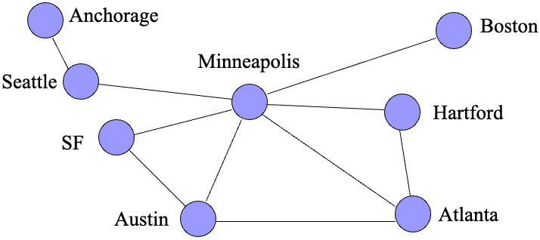
Northwest Airline Flight

Slide 3
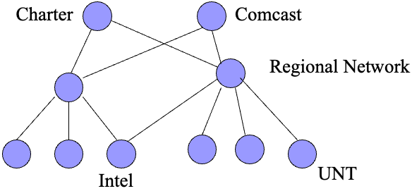
Computer Network Or Internet

Slide 4
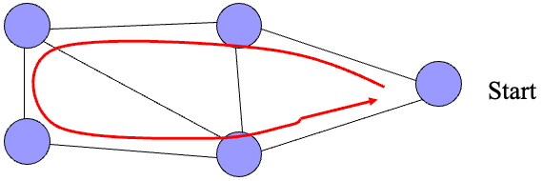
Application
Traveling Salesman
  Find the shortest path that connects all cities without a loop.

Slide 5
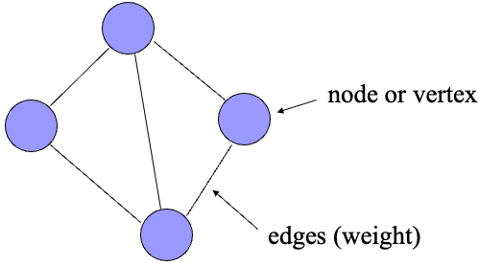
Concepts of Graphs

Slide 6
Graph Definition
A graph G = (V,E) is composed of:
V: set of vertices (nodes)
E: set of edges (arcs) connecting the vertices in V
An edge e = (u,v) is a pair of vertices
Example:
a
b
V= {a,b,c,d,e}
E= {(a,b),(a,c),(a,d),
(b,e),(c,d),(c,e), (d,e)}
c
d
e

Slide 7
Undirected vs. Directed Graph
A
A
D
B
D
B
C
C
Undirected Graph
edges have no direction
Directed Graph
edges have a specific direction from one vertex to another.

Slide 8
Degree of a Vertex
The degree of a vertex is the number of edges to that vertex
For directed graph,
  the in-degree of a vertex v is the number of edges
  that have v as the head
  the out-degree of a vertex v is the number of edges
  that have v as the tail
  if di is the degree of a vertex i in a graph G with n vertices and e edges, the number of edges is
Hint: Adjacent vertices are counted twice.

Slide 9
Degree of a Vertex
A
A
D
B
D
B
C
C
Degree(A)=?
Degree(B)=?
Degree(C)=?
Degree(D)=?
In-degree(A)=? Out-degree(A)=?
In-degree(B)=? Out-degree(B)=?
In-degree(C)=? Out-degree(C)=?
In-degree(D)=? Out-degree(D)=?

Slide 10
Subgraph
Subgraph:
  subset of vertices and edges
A
A
B
D
Subgraph 1
B
D
A
C
B
D
C
Subgraph 2

Slide 11
Simple Path
A simple path is a path such that all vertices are distinct, except that the first and the last could be the same.
  ABCD is a simple path
B
A
C
path
D

Slide 12
Cycle
A cycle is a path that starts and ends at the same point. For undirected graph, the edges are distinct.
  CBDC is a cycle
B
A
C
D
circle

Slide 13
Connected vs. Unconnected Graph
Connected Graph
Unconnected Graph

Slide 14
Directed Acyclic Graph
Directed Acyclic Graph (DAG) : directed graph without cycle

Slide 15
Weighted Graph
Weighted graph: a graph with numbers assigned to its edges
Weight: cost, distance, travel time, hop, etc.
0
10
20
1
1
2
4
5
3

Slide 16
Representation Of Graph
Two representations
  Adjacency Matrix
  Adjacency List

Slide 17
Adjacency Matrix
Assume N nodes in graph
Use 2D Matrix A[0…N-1][0…N-1]
  if vertex i and vertex j are adjacent in graph, A[i][j] = 1,
  otherwise A[i][j] = 0
  if vertex i has a loop, A[i][i] = 1
  if vertex i has no loop, A[i][i] = 0

Slide 18
Example of Adjacency Matrix
0
1
2
3

Slide 19
Example of Adjacency Matrix
A[i][j] | 0 | 1 | 2 | 3
0 | 0 | 1 | 1 | 0
1 | 1 | 0 | 1 | 1
2 | 1 | 1 | 0 | 1
3 | 0 | 1 | 1 | 0
0
1
2
3
0 1 1 0
1 0 1 1
1 1 0 1
0 1 1 0
So, Matrix A =

Slide 20
Example of Adjacency Matrix
0
1
So, Matrix A =?
2
3

Slide 21
Example of Adjacency Matrix
A[i][j] | 0 | 1 | 2 | 3
0 | 1 | 1 | 1 | 0
1 | 1 | 0 | 1 | 1
2 | 1 | 1 | 0 | 1
3 | 0 | 1 | 1 | 1
0
1
2
3
1 1 1 0
1 0 1 1
1 1 0 1
0 1 1 1
So, Matrix A =

Slide 22
Example of Adjacency Matrix
A[i][j] | 0 | 1 | 2 | 3
0 | 0 | 1 | 1 | 1
1 | 0 | 0 | 0 | 1
2 | 0 | 0 | 0 | 1
3 | 0 | 0 | 0 | 0
0
1
2
3
0 1 1 1
0 0 0 1
0 0 0 1
0 0 0 0
So, Matrix A =

Slide 23
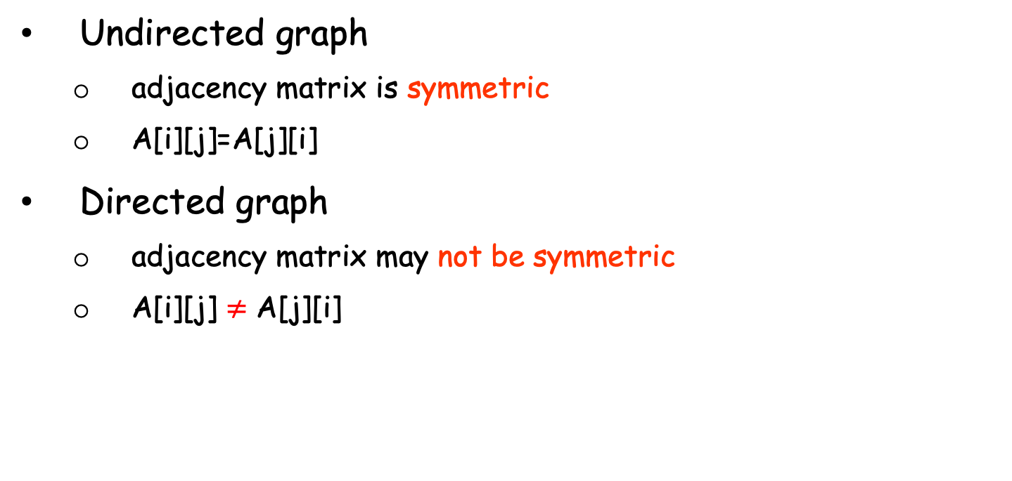
Undirected vs. Directed
Undirected graph
  adjacency matrix is symmetric
  A[i][j]=A[j][i]
Directed graph
  adjacency matrix may not be symmetric
  A[i][j] $≠$ A[j][i]

Slide 24
Weighted Graph
A[i][j] | 0 | 1 | 2 | 3
0 | 0 | 20 | 10 | 1
1 | 20 | 0 | 0 | 5
2 | 10 | 0 | 0 | 4
3 | 1 | 5 | 4 | 0
0
10
20
1
1
2
4
0 20 10 1
20 0 0 5
10 0 0 4
1 5 4 0
5
3
So, Matrix A =

Slide 25
Adjacency List
An array of list
the ith element of the array is a list of vertices that connect to vertex i
0
1
2
3
1
3
0
2
3
1
2
3
3
vertex 0 connect to vertex 1, 2 and 3
vertex 1 connects to 3
vertex 2 connects to 3

Slide 26
Weighted Graph
Weighted graph: extend each node with an addition field: weight
0
0
1
10
2
20
3
1
10
20
1
0
10
3
4
1
1
2
2
0
20
3
5
4
5
3
3
0
1
1
4
2
5

Slide 27
Comparison Of Representations
Cost | Adjacency Matrix | Adjacency List
Given two vertices u and v: find out whether u and v are adjacent | O(1) | degree of node O(N)
Given a vertex u: enumerate all neighbors of u | O(N) | degree of node O(N)
For all vertices: enumerate all neighbors of each vertex | O(N²) | Summations of all node degree O(E)

Slide 28
Complete Graph
There is an edge between any two vertices
Total number of edges in graph:
E = N(N-1)/2 = O(N²)

Slide 29
Sparse Graph
There is a very small number of edges in the graph
For example:
E = N-1= O(N)

Slide 30
Space Requirements
Memory space:
  adjacency matrix O(N²)
  adjacency list O(E)
Sparse graph
  adjacency list is better
Dense graph
  same running time

Slide 31
Graph Traversal
List out all cities that United Airline can reach from Hartford Airport
CHI
Hartford
SF
NYC
LA
W. DC

Slide 32
Graph Traversal
From vertex u, list out all vertices that can be reached in graph G
Set of nodes to expand
Each node has a flag to indicate visited or not

Slide 33
Traversal Algorithm
Step 1: { Hartford }
  find unvisited neighbors of Hartford
  { Hartford, NYC, CHI }
CHI
SF
Hartford
NYC
LA
W. DC

Slide 34
Traversal Algorithm
Step 2: { Hartford, NYC, CHI }
  find unvisited neighbors of NYC, CHI
  { Hartford, NYC, CHI, LA, SF }
CHI
SF
Hartford
NYC
LA
W. DC

Slide 35
Traversal Algorithm
Step 3: {Hartford, NYC, CHI, LA, SF }
  find unvisited neighbors of LA, SF
  no other new neighbors
CHI
SF
Hartford
NYC
LA
W. DC

Slide 36
Traversal Algorithm
Finally, we get all cities that United Airline can reach from Hartford Airport
  {Hartford, NYC, CHI, LA, SF }
CHI
SF
Hartford
NYC
LA
W. DC

Slide 37
Algorithm of Graph Traversal
Mark all nodes as unvisited
Pick a starting vertex u, add u to probing list
While ( probing list is not empty)
{
Remove a node v from probing list
Mark node v as visited
For each neighbor w of v, if w is unvisited, add w to the probing list
}

Slide 38
Graph Traversal Algorithms
Two algorithms
  Depth First Traversal
  Breadth First Traversal

Slide 39
Depth First Traversal
Probing List is implemented as stack (LIFO)
Example
  A’s neighbor: B, C, E
  B’s neighbor: A, C, F
  C’s neighbor: A, B, D
  D’s neighbor: E, C, F
  E’s neighbor: A, D
  F’s neighbor: B, D
  start from vertex A
A
B
E
C
F
D

Slide 40
Depth First Traversal (Cont)
  A’s neighbor: B C E
  B’s neighbor: A C F
  C’s neighbor: A B D
  D’s neighbor: E C F
  E’s neighbor: A D
  F’s neighbor: B D
A
B
E
C
F
D
Initial State
  Visited Vertices { }
  Probing Vertices { A }
  Unvisited Vertices { A, B, C, D, E, F }
stack
A

Slide 41
Depth First Traversal (Cont)
  A’s neighbor: B C E
  B’s neighbor: A C F
  C’s neighbor: A B D
  D’s neighbor: E C F
  E’s neighbor: A D
  F’s neighbor: B D
A
B
E
C
F
D
Peek a vertex from stack, it is A, mark it as visited
Find A’s first unvisited neighbor, push it into stack
  Visited Vertices { A }
  Probing vertices { A, B }
  Unvisited Vertices { B, C, D, E, F }
B
A
A
stack

Slide 42
Depth First Traversal (Cont)
  A’s neighbor: B C E
  B’s neighbor: A C F
  C’s neighbor: A B D
  D’s neighbor: E C F
  E’s neighbor: A D
  F’s neighbor: B D
A
B
E
C
F
D
Peek a vertex from stack, it is B, mark it as visited
Find B’s first unvisited neighbor, push it in stack
  Visited Vertices { A, B }
  Probing Vertices { A, B, C }
  Unvisited Vertices { C, D, E, F }
C
B
B
A
A
stack

Slide 43
Depth First Traversal (Cont)
  A’s neighbor: B C E
  B’s neighbor: A C F
  C’s neighbor: A B D
  D’s neighbor: E C F
  E’s neighbor: A D
  F’s neighbor: B D
A
B
E
C
F
D
Peek a vertex from stack, it is C, mark it as visited
Find C’s first unvisited neighbor, push it in stack
  Visited Vertices { A, B, C }
  Probing Vertices { A, B, C, D }
  Unvisited Vertices { D, E, F }
D
C
C
B
B
A
A
stack

Slide 44
Depth First Traversal (Cont)
  A’s neighbor: B C E
  B’s neighbor: A C F
  C’s neighbor: A B D
  D’s neighbor: E C F
  E’s neighbor: A D
  F’s neighbor: B D
A
B
E
C
F
D
Peek a vertex from stack, it is D, mark it as visited
Find D’s first unvisited neighbor, push it in stack
  Visited Vertices { A, B, C, D }
  Probing Vertices { A, B, C, D, E }
  Unvisited Vertices { E, F }
E
D
D
C
C
B
B
A
A
stack

Slide 45
Depth First Traversal (Cont)
  A’s neighbor: B C E
  B’s neighbor: A C F
  C’s neighbor: A B D
  D’s neighbor: E C F
  E’s neighbor: A D
  F’s neighbor: B D
A
B
E
C
F
D
Peek a vertex from stack, it is E, mark it as visited
Find E’s first unvisited neighbor, no vertex found, Pop E
  Visited Vertices { A, B, C, D, E }
  Probing Vertices { A, B, C, D }
  Unvisited Vertices { F }
E
D
D
C
C
B
B
A
A
stack

Slide 46
Depth First Traversal (Cont)
  A’s neighbor: B C E
  B’s neighbor: A C F
  C’s neighbor: A B D
  D’s neighbor: E C F
  E’s neighbor: A D
  F’s neighbor: B D
A
B
E
C
F
D
Peek a vertex from stack, it is D, mark it as visited
Find D’s first unvisited neighbor, push it in stack
  Visited Vertices { A, B, C, D, E }
  Probing Vertices { A, B, C, D, F}
  Unvisited Vertices { F }
F
D
D
C
C
B
B
A
A
stack

Slide 47
Depth First Traversal (Cont)
  A’s neighbor: B C E
  B’s neighbor: A C F
  C’s neighbor: A B D
  D’s neighbor: E C F
  E’s neighbor: A D
  F’s neighbor: B D
A
B
E
C
F
D
Peek a vertex from stack, it is F, mark it as visited
Find F’s first unvisited neighbor, no vertex found, Pop F
  Visited Vertices { A, B, C, D, E, F }
  Probing Vertices { A, B, C, D}
  Unvisited Vertices { }
F
D
D
C
C
B
B
A
A
stack

Slide 48
Depth First Traversal (Cont)
  A’s neighbor: B C E
  B’s neighbor: A C F
  C’s neighbor: A B D
  D’s neighbor: E C F
  E’s neighbor: A D
  F’s neighbor: B D
A
B
E
C
F
D
Peek a vertex from stack, it is D, mark it as visited
Find D’s first unvisited neighbor, no vertex found, Pop D
  Visited Vertices { A, B, C, D, E, F }
  Probing Vertices { A, B, C }
  Unvisited Vertices { }
D
C
C
B
B
A
A
stack

Slide 49
Depth First Traversal (Cont)
  A’s neighbor: B C E
  B’s neighbor: A C F
  C’s neighbor: A B D
  D’s neighbor: E C F
  E’s neighbor: A D
  F’s neighbor: B D
A
B
E
C
F
D
Peek a vertex from stack, it is C, mark it as visited
Find C’s first unvisited neighbor, no vertex found, Pop C
  Visited Vertices { A, B, C, D, E, F }
  Probing Vertices { A, B }
  Unvisited Vertices { }
C
B
B
A
A
stack

Slide 50
Depth First Traversal (Cont)
  A’s neighbor: B C E
  B’s neighbor: A C F
  C’s neighbor: A B D
  D’s neighbor: E C F
  E’s neighbor: A D
  F’s neighbor: B D
A
B
E
C
F
D
Peek a vertex from stack, it is B, mark it as visited
Find B’s first unvisited neighbor, no vertex found, Pop B
  Visited Vertices { A, B, C, D, E, F }
  Probing Vertices { A }
  Unvisited Vertices { }
B
A
A
stack

Slide 51
Depth First Traversal (Cont)
  A’s neighbor: B C E
  B’s neighbor: A C F
  C’s neighbor: A B D
  D’s neighbor: E C F
  E’s neighbor: A D
  F’s neighbor: B D
A
B
E
C
F
D
Peek a vertex from stack, it is A, mark it as visited
Find A’s first unvisited neighbor, no vertex found, Pop A
  Visited Vertices { A, B, C, D, E, F }
  Probing Vertices { }
  Unvisited Vertices { }
A
stack

Slide 52
Depth First Traversal (Cont)
  A’s neighbor: B C E
  B’s neighbor: A C F
  C’s neighbor: A B D
  D’s neighbor: E C F
  E’s neighbor: A D
  F’s neighbor: B D
A
B
E
C
F
D
Now probing list is empty
End of Depth First Traversal
  Visited Vertices { A, B, C, D, E, F }
  Probing Vertices { }
  Unvisited Vertices { }
stack

Slide 53
Breadth First Traversal
Probing List is implemented as queue (FIFO)
Example
  A’s neighbor: B C E
  B’s neighbor: A C F
  C’s neighbor: A B D
  D’s neighbor: E C F
  E’s neighbor: A D
  F’s neighbor: B D
  start from vertex A
A
B
E
C
F
D

Slide 54
Breadth First Traversal (Cont)
  A’s neighbor: B C E
  B’s neighbor: A C F
  C’s neighbor: A B D
  D’s neighbor: E C F
  E’s neighbor: A D
  F’s neighbor: B D
A
B
E
C
F
D
Initial State
  Visited Vertices { }
  Probing Vertices { A }
  Unvisited Vertices { A, B, C, D, E, F }
A
queue

Slide 55
Breadth First Traversal (Cont)
  A’s neighbor: B C E
  B’s neighbor: A C F
  C’s neighbor: A B D
  D’s neighbor: E C F
  E’s neighbor: A D
  F’s neighbor: B D
A
B
E
C
F
D
Delete first vertex from queue, it is A, mark it as visited
Find A’s all unvisited neighbors, mark them as visited, put them into queue
  Visited Vertices { A, B, C, E }
  Probing Vertices { B, C, E }
  Unvisited Vertices { D, F }
A
B
C
E
queue

Slide 56
Breadth First Traversal (Cont)
  A’s neighbor: B C E
  B’s neighbor: A C F
  C’s neighbor: A B D
  D’s neighbor: E C F
  E’s neighbor: A D
  F’s neighbor: B D
A
B
E
C
F
D
Delete first vertex from queue, it is B, mark it as visited
Find B’s all unvisited neighbors, mark them as visited, put them into queue
  Visited Vertices { A, B, C, E, F }
  Probing Vertices { C, E, F }
  Unvisited Vertices { D }
B
C
E
C
E
F
queue

Slide 57
Breadth First Traversal (Cont)
  A’s neighbor: B C E
  B’s neighbor: A C F
  C’s neighbor: A B D
  D’s neighbor: E C F
  E’s neighbor: A D
  F’s neighbor: B D
A
B
E
C
F
D
Delete first vertex from queue, it is C, mark it as visited
Find C’s all unvisited neighbors, mark them as visited, put them into queue
  Visited Vertices { A, B, C, E, F, D }
  Probing Vertices { E, F, D }
  Unvisited Vertices { }
C
E
F
E
F
D
queue

Slide 58
Breadth First Traversal (Cont)
  A’s neighbor: B C E
  B’s neighbor: A C F
  C’s neighbor: A B D
  D’s neighbor: E C F
  E’s neighbor: A D
  F’s neighbor: B D
A
B
E
C
F
D
Delete first vertex from queue, it is E, mark it as visited
Find E’s all unvisited neighbors, no vertex found
  Visited Vertices { A, B, C, E, F, D }
  Probing Vertices { F, D }
  Unvisited Vertices { }
E
F
D
F
D
queue

Slide 59
Breadth First Traversal (Cont)
  A’s neighbor: B C E
  B’s neighbor: A C F
  C’s neighbor: A B D
  D’s neighbor: E C F
  E’s neighbor: A D
  F’s neighbor: B D
A
B
E
C
F
D
Delete first vertex from queue, it is F, mark it as visited
Find F’s all unvisited neighbors, no vertex found
  Visited Vertices { A, B, C, E, F, D }
  Probing Vertices { D }
  Unvisited Vertices { }
F
D
D
queue

Slide 60
Breadth First Traversal (Cont)
  A’s neighbor: B C E
  B’s neighbor: A C F
  C’s neighbor: A B D
  D’s neighbor: E C F
  E’s neighbor: A D
  F’s neighbor: B D
A
B
E
C
F
D
Delete first vertex from queue, it is D, mark it as visited
Find D’s all unvisited neighbors, no vertex found
  Visited Vertices { A, B, C, E, F, D }
  Probing Vertices { }
  Unvisited Vertices { }
D
queue

Slide 61
Breadth First Traversal (Cont)
  A’s neighbor: B C E
  B’s neighbor: A C F
  C’s neighbor: A B D
  D’s neighbor: E C F
  E’s neighbor: A D
  F’s neighbor: B D
A
B
E
C
F
D
Now the queue is empty
End of Breadth First Traversal
  Visited Vertices { A, B, C, E, F, D }
  Probing Vertices { }
  Unvisited Vertices { }
queue

Slide 62
Difference Between DFT & BFT
Depth First Traversal (DFT)
  order of visited: A, B, C, D, E, F
Breadth First Traversal (BFT)
  order of visited: A, B, C, E, F, D
A
B
E
C
F
D

